Slide 1
Unit – III ( Parsing)
BSc CSIT 5th Semester
2020
Mid-Western University, Surkhet
Prepared By:
Dabbal Singh Mahara

Slide 2
Syntax Analysis
By design, every programming language has precise rules that prescribe the syntactic structure of well-formed programs.
In C, for example, a program is made up of functions, a function out of declarations and statements, a statement out of expressions, and so on.
The syntax of programming language constructs can be specified by context-free grammars or BNF notations.
From certain classes of grammars, we can construct automatically an efficient parser that determines the syntactic structure of a source program.
The syntax analyzer is also called parser. The parser obtaines a string of tokens from the lexical analyzer and verifies that the string of token names can be generated by the grammar for the source language.
The parser also reports any syntax errors in the program and recover from communly occurring errors to continue processing the remainder of the program.
That is, the parser must distinguish from valid and invalid sequences of tokens.

Slide 3
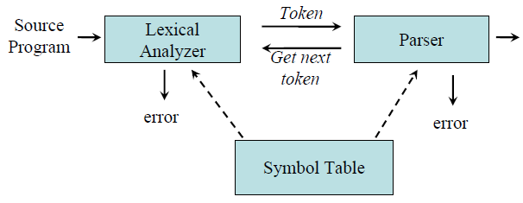
Position of Parser in compiler
It works in lock-step with the lexical analyzer and is responsible for creating a parse-tree of the source code.
Parse Tree
Functions of the parser : 1. It verifies the structure generated by the tokens based on the grammar. 2. It constructs the parse tree. 3. It reports the errors. 4. It performs error recovery.

Slide 4
Example: input and output of parser
Source program : x = y +z * 2
lexical analyzer outputs: <x, id> <=, assign_op> <y, id> < +, Add_op> <z, id> <*, mul_op> <2,num>
This sequence of tokens is input to the parser.
Parser creates a parse tree as below:
S
id
=
E
CFG for assignment statement
S -> id = E
E -> E + T | T
T -> T * F | F
F -> id | num
x
E
+
T
T
T
*
F
F
F
num
id
id
2
y
z

Slide 5
Context-Free Grammar
A Context-Free Grammar is a quadruple that consists of terminals, non-terminals, start symbol and productions. That is, G = (N, T, P, S)
Terminals : These are the basic symbols from which strings are formed.
Non-Terminals : These are the syntactic variables that denote a set of strings. These help to define the language generated by the grammar.
Start Symbol : One non-terminal in the grammar is denoted as the “Start-symbol” and the set of strings it denotes is the language defined by the grammar.
Productions : It specifies the manner in which terminals and non-terminals can be combined to form strings. Each production consists of a non-terminal, followed by an arrow, followed by a string of non-terminals and terminals.
Example of context-free grammar: The following grammar defines simple arithmetic expressions:
expr → expr op expr expr → (expr) expr → - expr expr → id op → + op → - op → * op → / op → ↑
In this grammar,
id + - * / ↑ ( ) are terminals.
expr , op are non-terminals.
expr is the start symbol.
Each line is a production

Slide 6
Derivations
Derivation is a process that generates a valid string with the help of grammar by replacing the non-terminals on the left with the string on the right side of the production.
Example : Consider the following grammar for arithmetic expressions : E → E+E | E*E | ( E ) | - E | id
To generate a valid string - ( id+id ) from the grammar the steps are 1. E → - E 2. E → - ( E ) 3. E → - ( E+E ) 4. E → - ( id+E ) 5. E → - ( id+id )
In the above derivation,
E is the start symbol.
- (id+id) is the required sentence (only terminals).
Strings such as E, -E, -(E), . . . are called sentinel forms.

Slide 7
Types of derivations
The two types of derivation are: 1. Left most derivation 2. Right most derivation.
In leftmost derivations, the leftmost non-terminal in each sentinel is always chosen first for replacement.
In rightmost derivations, the rightmost non-terminal in each sentinel is always chosen first for replacement.
Example: Given grammar G : E → E+E | E*E | ( E ) | - E | id
Sentence to be derived : – (id+id)
LEFTMOST DERIVATION RIGHTMOST DERIVATION E → - E E → - E E → - ( E ) E → - ( E ) E → - ( E+E ) E → - (E+E ) E → - ( id+E ) E → - ( E+id ) E → - ( id+id ) E → - ( id+id )
String that appear in leftmost derivation are called left sentinel forms.
String that appear in rightmost derivation are called right sentinel forms.

Slide 8
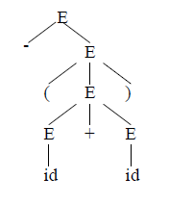
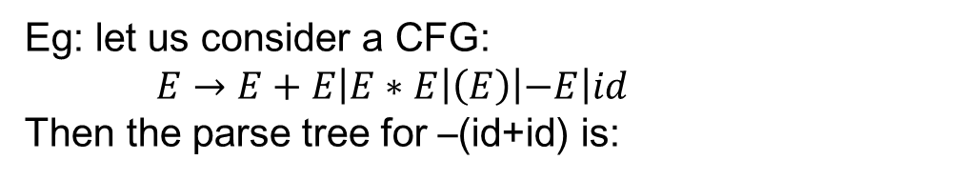
Parse Tree
Graphical representation of a derivation or deduction is called a parse tree.
The root node is labeled by start symbol.
Inner nodes of a parse tree are non-terminal symbols.
The leaves of a parse tree are terminal symbols.
Eg: let us consider a CFG:
$E→E+E\left|E∗E\right|\left(E\right)\left|−E\right|id$
Then the parse tree for –(id+id) is:

Slide 9
Ambiguity
A grammar that produces more than one parse for some sentence is said to be ambiguous grammar.
A grammar G is said to be ambiguous if there is a string w є L(G) for which we can construct more than one parse tree rooted at start symbol of the production.
Example : Given grammar G : E → E+E | E*E | ( E ) | - E | id
The sentence id+id*id has the following two distinct leftmost derivations:
E → E+ E E → E* E E → id + E E → E + E * E E → id + E * E E → id + E * E E → id + id * E E → id + id * E E → id + id * id E → id + id * id

Slide 10
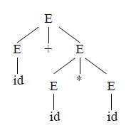
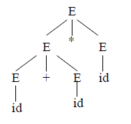
The two corresponding parse trees are :

Slide 11
Eliminating Left Recursion:
A grammar is said to be left recursive if it has a non-terminal A such that there is a derivation A=>Aα for some string α.
Top-down parsing methods cannot handle left-recursive grammars.
Hence, left recursion can be eliminated as follows: If there is a production A → Aα | β, it can be replaced with a sequence of two productions
A → βA’
A’ → αA’ | ε without changing the set of strings derivable from A.
Example : Consider the following grammar for arithmetic expressions: E → E+T | T T → T*F | F F → (E) | id
The grammar after eliminating left recursion is E → TE’ E’ → +TE’ | ε T → FT’ T’ → *FT’ | ε F → (E) | id

Slide 12
Left factoring
Left factoring is a grammar transformation that is useful for producing a grammar suitable for predictive parsing.
When it is not clear which of two alternative productions to use to expand a non-terminal A, we can rewrite the A-productions to defer the decision until we have seen enough of the input to make the right choice.
If there is any production A → αβ1 | αβ2 , it can be rewritten as A → αA’
A’ → β1 | β2
Consider the grammar , G :
S → iEtS | iEtSeS | a E → b
Left factored, this grammar becomes S → iEtSS’ | a S’ → eS | ε E → b

Slide 13
PARSING
It is the process of analyzing a continuous stream of input in order to determine its grammatical structure with respect to a given formal grammar.
Types of parsing: 1. Top down parsing 2. Bottom up parsing
Top–down parsing : A parser can start with the start symbol and try to transform it to the input string. Example : LL Parsers.
Bottom–up parsing : A parser can start with input and attempt to rewrite it into the start symbol. Example : LR Parsers.

Slide 14
TOP-DOWN PARSING
It can be viewed as an attempt to find a left-most derivation for an input string or an attempt to construct a parse tree for the input starting from the root to the leaves.
It involves generating the string starting from the first non-terminal and repeatedly applying production rules.
Types of Top down parsing
1. Recursive descent parsing 2. Predictive parsing

Slide 15
1. RECURSIVE DESCENT PARSING
Recursive descent parsing is one of the top-down parsing techniques that uses a set of recursive procedures to scan its input.
It is a general parsing technique, but not widely used.
Not efficient
This parsing method may involve backtracking, that is, making repeated scans of the input.
Example for backtracking : Consider the grammar G
S → cAd A → ab | a
and the input string w=cad.
The parse tree can be constructed using the following top-down approach :
Step1: Initially create a tree with single node labeled S. An input pointer points to ‘c’, the first symbol of w. Expand the tree with the production of S.
S
c
A
d

Slide 16
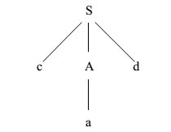
RECURSIVE DESCENT PARSING
Step2: The leftmost leaf ‘c’ matches the first symbol of w, so advance the input pointer to the second symbol of w ‘a’ and consider the next leaf ‘A’. Expand A using the first alternative.
Step3: The second symbol ‘a’ of w also matches with second leaf of tree. So advance the input pointer to third symbol of w ‘d’. But the third leaf of tree is b which does not match with the input symbol d. Hence discard the chosen production and reset the pointer to second position. This is called backtracking.
Step4: Now try the second alternative for A. Now we can halt and announce the successful completion of parsing
S
c
A
d
a
b

Slide 17
Example for recursive decent parsing
A left-recursive grammar can cause a recursive-descent parser to go into an infinite loop. Hence, elimination of left-recursion must be done before parsing.
Consider the grammar for arithmetic expressions E → E+T | T T → T*F | F F → (E) | id
After eliminating the left-recursion the grammar becomes, E → TE’ E’ → +TE’ | ε T → FT’ T’ → *FT’ | ε F → (E) | id Now we can write the procedure for grammar as follows:

Slide 18
Recursive procedure:
Procedure E()
begin T( ); EPRIME( );
end
II. Procedure EPRIME( )
begin If input_symbol=’+’ then ADVANCE( ); T( ); EPRIME( );
end
Procedure T( )
begin F( ); TPRIME( );
end
Procedure TPRIME( )
begin If input_symbol=’*’ then ADVANCE( ); F( ); TPRIME( ); end
Procedure F( )
begin If input-symbol=’id’ then ADVANCE( ); else if input-symbol=’(‘ then ADVANCE( ); E( ); else if input-symbol=’)’ then ADVANCE( );
end
else ERROR( );

Slide 19
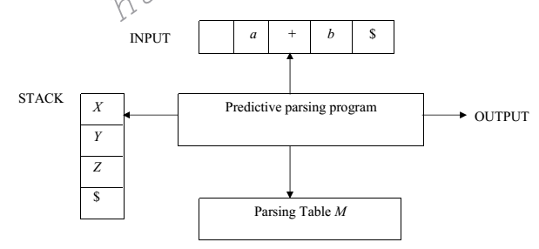
2. PREDICTIVE PARSING
Predictive parsing is a special case of recursive descent parsing where no backtracking is required.
The key problem of predictive parsing is to determine the production to be applied for a non-terminal in case of alternatives
A table driven predictive parser has an input buffer, a stack, a parsing table and an output stream.
Fig. model of a non-recursive predictive parser

Slide 20
Predictive Parser
Input buffer:
It contains the string to be parsed followed by a special symbol $.
Stack:
A stack contains a sequence of grammar symbols with $ on the bottom. Initially it contains the symbol $.
Parsing table:
It is a two dimensional array M [A, a] where ‘A’ is non-terminal and ‘a’ is a terminal symbol.
Output stream:
A production rule representing a step of the derivation sequence of the string in the input buffer.

Slide 21
Predictive parsing program:
The parser is controlled by a program that considers X, the symbol on top of stack, and a, the current input symbol. These two symbols determine the parser action. There are three possibilities:
If X = a = $, the parser halts and announces successful completion of parsing.
If X = a ≠ $, the parser pops X off the stack and advances the input pointer to the next input symbol.
If X is a non-terminal , the program consults entry M[X, a] of the parsing table M. This entry will either be an X-production of the grammar or an error entry. If M[X, a] = {X → UVW},the parser replaces X on top of the stack by WVU. If M[X, a] = error, the parser calls an error recovery routine.

Slide 22
Algorithm for nonrecursive predictive parsing:
Input : A string w and a parsing table M for grammar G.
Output : If w is in L(G), a leftmost derivation of w; otherwise, an error indication.
Method : Initially, the parser has $S on the stack with S, the start symbol of G on top, and w$ in the input buffer. The program that utilizes the predictive parsing table M to produce a parse for the input is as follows:
set ip to point to the first symbol of w$;
repeat let X be the top stack symbol and a the symbol pointed to by ip;
if X is a terminal or $ then
if X = a then pop X from the stack and advance ip
else error()
else /* X is a non-terminal */
if M[X, a] = X →Y1Y2 … Yk then begin pop X from the stack; push Yk, Yk-1, … ,Y1 onto the stack, with Y1 on top; output the production X → Y1 Y2 . . . Yk
end
else error()
until X = $ /* stack is empty */

Slide 23
Predictive parsing table construction
The construction of a predictive parser is aided by two functions associated with a grammar G : 1. FIRST 2. FOLLOW
FIRST(α) is a set of the terminal symbols which occur as first symbols in strings derived from α where α is any string of grammar symbols.
If α derives to ∈, then ∈ is also in FIRST (α).
Rules for first( )
If X is terminal, then FIRST(X) is {X}.
If X → ε is a production, then add ε to FIRST(X).
If X is non-terminal and X → aα is a production then add a to FIRST(X).
If X is non-terminal and X → Y1 Y2…Yk is a production, then place a in FIRST(X) if for some i, a is in FIRST(Y_{i}), and ε is in all of FIRST(Y₁),…,FIRST(Y_{i-1}); that is, Y₁,….Y_{i-1} => ε. If ε is in FIRST(Y_{j}) for all j=1,2,..,k, then add ε to FIRST(X)

Slide 24
Example: Consider the following grammar and compute first of all non-terminals.
E → TE’ E’ → +TE’ | ε T → FT’ T’ → *FT’ | ε F → (E) | id
First( ) :
FIRST(E) = { ( , id} FIRST(E’) ={+ , ε } FIRST(T) = { ( , id} FIRST(T’) = {*, ε } FIRST(F) = { ( , id }

Slide 25
Follow (A)
FOLLOW (A) is the set of the terminals which occur immediately after (follow) the non-terminal A in the strings derived from the starting symbol.
Rules for follow( )
If S is a start symbol, then FOLLOW(S) contains $.
If there is a production A → αBβ, then everything in FIRST(β) except ε is placed in follow(B).
If there is a production A → αB, or a production A → αBβ where FIRST(β) contains ε, then everything in FOLLOW(A) is in FOLLOW(B).

Slide 26
Example: Consider the following grammar and compute follow of all the non-terminals.
E → TE’ E’ → +TE’ | ε T → FT’ T’ → *FT’ | ε F → (E) | id
Follow( ) :
FOLLOW(E) = { $, ) } FOLLOW(E’) = { $, ) } FOLLOW(T) = { +, $, ) } FOLLOW(T’) = { +, $, ) } FOLLOW(F) = {+, * , $ , ) }

Slide 27
Algorithm for construction of predictive parsing table
Input : Grammar G
Output : Parsing table M
Method :
For each production A → α of the grammar, do steps 2 and 3.
For each terminal a in FIRST(α), add A → α to M[A, a].
If ε is in FIRST(α), add A → α to M[A, b] for each terminal b in FOLLOW(A). If ε is in FIRST(α) and $ is in FOLLOW(A) , add A → α to M[A, $].
Make each undefined entry of M be error.

Slide 28
Example: Consider the following grammar and construct LL(1) parsing table. Parse the string id+id*id.
E → TE’ E’ → +TE’ | ε T → FT’ T’ → *FT’ | ε F → (E) | id
First( ) :
FIRST(E) = { ( , id} FIRST(E’) ={+ , ε } FIRST(T) = { ( , id} FIRST(T’) = {*, ε } FIRST(F) = { ( , id }
Follow( ) :
FOLLOW(E) = { $, ) } FOLLOW(E’) = { $, ) } FOLLOW(T) = { +, $, ) } FOLLOW(T’) = { +, $, ) } FOLLOW(F) = {+, * , $ , ) }

Slide 29
Predictive parsing table or LL(1) parsing table
Non-Terminal | id | + | * | ( | ) | $
E | E->TE’ |  |  | E-> TE’
E’ |  | E’-> +TE’ |  |  | E’ -> ϵ | E’ -> ϵ
T | T -> FT’ |  |  | T -> FT’
T’ |  | T’ -> ϵ | T -> *FT’ |  | T’ -> ϵ | T’ -> ϵ
F | F -> id |  |  | F -> (E)

Slide 30
LL(1) parsing of the string: id+id*id
Stack | Input | Output
$E | id+id*id$
$E’T | id+id*id$ | E-> TE’
$E’T’F | id+id*id$ | T -> FT’
$E’T’id | id+id*id$ | F -> id
$E’T’ | +id*id$
$E’ | +id*id$ | T’ -> ϵ
$E’T+ | +id*id$ | E’ ->+TE’
$E’T | id*id$
$E’T’F | id*id$ | T -> FT’
$E’T’id | id*id$ | F -> id
$E’T’ | *id$
$E’T’F* | *id$ | T’ -> *FT’
$E’T’F | id$
$E’T’id | id$ | F -> id
$E’T’ | $
$E’ | $ | T’-> ϵ
$ | $ | E’ -> ϵ

Slide 31
LL(1) Grammar
The parsing table entries are single entries. So each location has not more than one entry. This type of grammar is called LL(1) grammar.
A left recursive, not left factored and ambiguous grammar cannot be a LL(1) grammar (i.e. left recursive, not left factored and ambiguous grammar may have multiply –defined entries in parsing table).
LL(1): first L means input is scanned from left to right, second L means left most derivation and 1 means one input used as a look-ahead symbol to determine parser action.
A grammar is LL(1) if and only if the following conditions hold for two distinctive production rules: A -> α and A -> β ,
Both α and β cannot devie string starting with same terminals.
At most one of α and β can derive to ϵ.
If β can derive ϵ then α cannot derive to any string starting with a terminal in FOLLOW(A).

Slide 32
Exercise
Consider this following grammar: S → iEtS | iEtSeS | a E → b Find whether this grammar is LL(1) or not.
For the grammar:
S -> [C] S | ϵ
C -> {A} C | ϵ
A -> A ( ) | ϵ
Construct LL(1) parsing table.

Slide 33
Bottom-Up Parsing
Constructing a parse tree for an input string beginning at the leaves and going towards the root is called bottom-up parsing.
A general type of bottom-up parser is a shift-reduce parser.
SHIFT-REDUCE PARSING
Shift-reduce parsing is a type of bottom-up parsing that attempts to construct a parse tree for an input string beginning at the leaves (the bottom) and working up towards the root (the top).
Reduction:
The process of replacing a substring by a non-terminal in bottom-up parsing is called reduction. It is a reverse process of production.
Eg: S -> aA
Here, if replacing aA by S then such a replacement is called reduction.

Slide 34
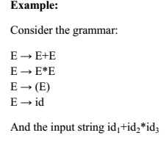
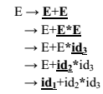
Handle
A handle of a string is a substring that matches the right side of a production, and whose reduction to the non-terminal on the left side of the production represents one step along the reverse of a rightmost derivation.
If the grammar is unambiguous, then every right-sentential form of the grammar has exactly one handle.
The right most derivation is:
In above derivation all the underlined substrings are handles.

Slide 35
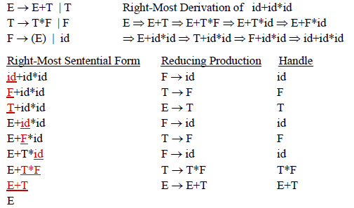
Example: A Shift-Reduce Parser with Handle

Slide 36
Stack Implementation of Shift-Reduce Parser
The stack holds the grammar symbols and input buffer holds the string w to be parsed.
1. Initially stack contains only the sentinel $, and input buffer contains the input string w$.
2. While stack not equal to $S or not error and input not $ do
(a) While there is no handle at the top of stack, do shift input buffer and push the symbol onto stack
(b) If there is a handle on top of stack, then pop the handle and reduce the handle with its non-terminal and push it onto stack
3. Done
Actions in shift-reduce parser:
shift – The next input symbol is shifted onto the top of the stack.
reduce – The parser replaces the handle within a stack with a non-terminal.
accept – The parser announces successful completion of parsing.
error – The parser discovers that a syntax error has occurred and calls an error recovery routine.

Slide 37
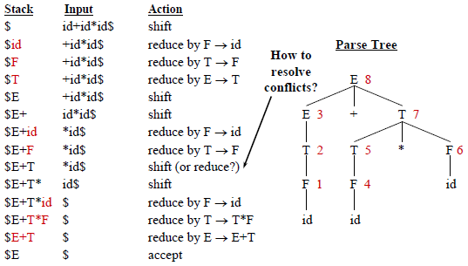
Stack Implementation of S-R Parser

Slide 38
Conflicts in shift-reduce parsing:
There are two conflicts that occur in shift shift-reduce parsing:
Shift-reduce conflict: The parser cannot decide whether to shift or to reduce.
Reduce-reduce conflict: The parser cannot decide which of several reductions to make.
Shift-Reduce Conflict
Here, the parser is not able to decide whether to shift or to reduce.
Example: A -> ab | abcd
The stack contains $ab, and the input buffer contains cd$, the parser cannot decide whether to reduce $ab to $A or to shift two more symbols before reducing.
Reduce-Reduce Conflict
Here, the parser cannot decide which sentential form to use for reduction.
For example : A -> bc and B -> abc.
The stack contains $abc, the parser cannot decide whether to reduce it to $aA or to $B.

Slide 39
Operator Precedence Parsing
It is an efficient technique for constructing shift-reduce parsers for a small class of grammars known as operator grammar.
These grammars have the property that no production on right side is ɛ or has two adjacent nonterminals.
Example: E → E + E | E –E | E ∗E | E/E | (E) | id is an operator grammar.
These parser rely on the following three precedence relations:
Relation | Meaning
a <· b | a yields precedence to b
a =· b | a has the same precedence as b
a ·> b | a takes precedence over b

Slide 40
Rules for binary operations
If operator θ1 has higher precedence than operator θ2, then
make θ1 . > θ2 and θ2 < . θ1
2. If operators θ1 and θ2, are of equal precedence, then
make θ1 . > θ2 and θ2 . > θ1 if operators are left associative
θ1 < . θ2 and θ2 < . θ1 if right associative
Make the following for all operators θ:
θ < . id , id . > θ
θ < . ( , ( < . θ
) . > θ , θ . > )
θ . > $ , $ < . θ 4. Also make ( = ) , ( <.( , ) .> ) , ( <. id , id .> ) , $ <. id , id .> $ , $ <. ( , ) .> $
Example:
Construct operator-precedence relation table for the grammar
E → E+E | E-E | E*E | E/E | E↑E | (E) | -E | id
Assume that:
↑ is of highest precedence and right-associative
* and / are of next higher precedence and left-associative, and
+ and - are of lowest precedence and left-associative

Slide 41
Precedence Relation Table
 | + | - | * | / | ↑ | id | ( | ) | $
+ | .> | .> | <. | <. | <. | <. | <. | .> | .>
- | .> | .> | <. | <. | <. | <. | <. | .> | .>
* | .> | .> | .> | .> | <. | <. | <. | .> | .>
/ | .> | .> | .> | .> | <. | <. | <. | .> | .>
↑ | .> | .> | .> | .> | <. | <. | <. | .> | .>
id | .> | .> | .> | .> | .> |  |  | .> | .>
( | <. | <. | <. | <. | <. | <. | <. | =
) | .> | .> | .> | .> | .> |  |  | .> | .>
$ | <. | <. | <. | <. | <. | <. | <.

Slide 42
Operator precedence parsing algorithm
Input : An input string w and a table of precedence relations.
Output : If w is well formed, a skeletal parse tree ,with a placeholder non-terminal E labeling all interior nodes; otherwise, an error indication.
Method : Initially the stack contains $ and the input buffer the string w $. To parse, we execute the following program :
Initialize: Set ip to point to the first symbol of w$ Repeat:
if $ is on the top of the stack and ip points to $ then return
else
Let a be the top terminal on the top of stack, and b the symbol pointed to by ip
if a <· b or a =· b then
push b onto the stack
advance ip to the next input symbol
else if a ·> b then repeat pop the stack until the top stack terminal a <. b . else error() end

Slide 43
Example: Trace operator precedence parsing algorithm for Input string: id * id + id Grammar: E -> E+E | E*E | id
 | id | + | * | $
id |  | ·> | ·> | ·>
+ | <· | ·> | <· | ·>
* | <· | ·> | ·> | ·>
$ | <· | <· | <·
Precedence Relation Table
E
+
E
E
id
*
id
id

Slide 44
Bornat’s Method for constructing Precedence Relation Table
The intuitive approach may allow us to assigning precedence to conventional operators, but we need to be able to include all terminals in the grammar. some more general approach is needed.
Following Bornat, we can use the following method, based on first operator and last operator lists.
Firsttop is a list of all the operator or terminals which can appear first on right side of a production and lasttop is list of all terminal symbols or operators that appear on last.
The steps are:
For each non-terminal, construct Firsttop list containing the first terminal in each production for that non-terminal. If non-terminal is the first symbol on the right, include both it and the first terminal following: i.e. for each production X -> a.....| Bc...., then include a, c and B in X's Firsttop list.
Similarly construct a Lasttop list for each non-terminal. eg. for each production Y -> ....u| ........vW, include u,v and W in lasttop list of Y.

Slide 45
Bornat’s Method contd..
Compute the Firsttop and Lasttop ist using Warshall's Closure Algorithm as follows: take each non-terminal in turn, in any order and look for it in all the fisttop list. Add its own Firsttop symbols to other in which it occurs. Similarly process the Lasttop lists.Then, non-terminals can be deleted from the list.
Construct precedence relation as follows:
Whenever terminal a immediately precedes non-terminal B in any production, put a <· α , where α is any terminal in firsttop of B.
Whenever terminal b immediately follows non-terminal C in any production, put β ·> b, where β is any terminal in lasttop of C.
Whenever a sequence aBc or ac occurs in any production put a =· c.
Add the relation $ <• a and a•>$ for all terminals in firsttop and lastop lists respectively for start symbol, S. Any entry left blank indicates that two symbols should never occur consecutively in a handle . Such a sequence is a syntax error.

Slide 46
Example:
Consider the grammar:
S -> A
A -> T | A + T | A – T
T -> F | T * F | T / F
F -> P | P ↑ F
P -> i | n | ( A )
Applying Steps 1 and 2
Symbol | Firsttop | Lasttop
S | A | A
A | A, T, +, - | T, +, -
T | F, T, *, / | F, *. /
F | P, ↑ | P, F, ↑
P | i, n, ( | i, n, )

Slide 47
Applying step 3
Symbol | Firsttop | Lasttop
S | A, +, -, T, F,*,/, P, ↑, i,n,( | A, T, +, -, F, *. /, ↑, i, n, )
A | A, T, +, -,F, ,*, /, P, ↑, i,n,( | T, +, -, F, *. /, P, ↑, i, n, )
T | F, T, *, /, P, ↑, i,n,( | F, *. /P, ↑, i, n, )
F | P, ↑, i, n, ( | P, F, ↑, i, n, )
P | i, n, ( | i, n, )
Removing non-terminals
Symbol | Firsttop | Lasttop
S | +, - ,*,/ , ↑, i,n,( | +, -, *, /, ↑, i, n, )
A | +, - ,*, /, ↑, i,n,( | +, -, *, /, ↑, i, n, )
T | *, / , ↑, i,n,( | *, /, ↑, i, n, )
F | ↑, i, n, ( | ↑, i, n, )
P | i, n, ( | i, n, )

Slide 48
Finally Constructing Precedence Relation Table
 | + | - | * | / | ↑ | i | n | ( | ) | $
+ | .> | .> | <. | <. | <. | <. | <. | <. | .> | .>
- | .> | .> | <. | <. | <. | <. | <. | <. | .> | .>
* | .> | .> | .> | .> | <. | <. | <. | <. | .> | .>
/ | .> | .> | .> | .> | <. | <. | <. | <. | .> | .>
↑ | .> | .> | .> | .> | <. | <. | <. | <. | .> | .>
i | .> | .> | .> | .> | .> |  |  |  | .> | .>
n | .> | .> | .> | .> | .> |  |  |  | .> | .>
( | <. | <. | <. | <. | <. | <. | <. | <. | =
) | .> | .> | .> | .> | .> |  |  |  | .> | .>
$ | <. | <. | <. | <. | <. | <. | <. | <.

Slide 49
LR Parsers
An efficient bottom-up syntax analysis technique that can be used to parse a large class of CFG is called LR(k) parsing. The ‘L’ is for left-to-right scanning of the input, the ‘R’ for constructing a rightmost derivation in reverse, and the ‘k’ for the number of input symbols. When ‘k’ is omitted, it is assumed to be 1.
Advantages of LR parsing:
It recognizes virtually all programming language constructs for which CFG can be written.
It is an efficient non-backtracking shift-reduce parsing method.
A grammar that can be parsed using LR method is a proper superset of a grammar that can be parsed with predictive parser.
It detects a syntactic error as soon as possible.
Drawbacks of LR method
It is too much of work to construct a LR parser by hand for a programming language grammar. A specialized tool, called a LR parser generator, is needed. Example: YACC.
Types of LR parsing method:
SLR- Simple LR : Easiest to implement, least powerful.
CLR- Canonical LR : Most powerful, most expensive.
LALR- Look-Ahead LR : Intermediate in size and cost between the other two methods.

Slide 50
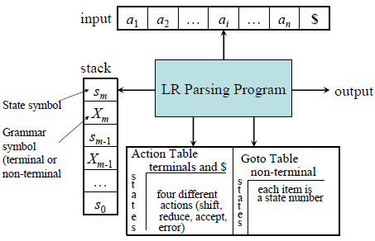
Structure of LR Parsers

Slide 51
Structure of LR Parsers
It consists of : an input, an output, a stack, a driver program, and a parsing table that has two parts (action and goto).
The driver program is the same for all LR parser.
The parsing program reads characters from an input buffer one at a time.
The program uses a stack to store a string of the form S₀X₁S₁X₂S₂…X_{m}S_{m}, where S_{m} is on top. Each X_{i} is a grammar symbol and each S_{i} is a state.
The parsing table consists of two parts : action and goto functions.
Action : The parsing program determines S_{m}, the state currently on top of stack, and a_{i}, the current input symbol. It then consults action[S_{m},a_{i}] in the action table which can have one of four values :
1. shift s, where s is a state,
2. reduce by a grammar production A → β,
3. accept, and
4. error.
Goto : The function goto takes a state and grammar symbol as arguments and produces a state.

Slide 52
LR Parsing algorithm
Input: An input string w and an LR parsing table with functions action and goto for grammar G. Output: If w is in L(G), a bottom-up-parse for w; otherwise, an error indication. Method: Initially, the parser has S0 on its stack, where S0 is the initial state, and w$ in the input buffer. The parser then executes the following program :
set ip to point to the first input symbol of w$;
repeat forever
let s be the state on top of the stack and a the symbol pointed to by ip;
if action[s, a] = shift s’ then begin
push a then s’ on top of the stack;
advance ip to the next input symbol end
else if action[s, a] = reduce A→β then begin
pop 2* | β | symbols off the stack;
let s’ be the state now on top of the stack;
push A then goto[s’, A] on top of the stack;
output the production A→ β end
else if action[s, a] = accept then return
else error( )
end

Slide 53
CONSTRUCTING SLR(1) PARSING TABLE:
To perform SLR parsing, take grammar as input and do the following:
Find LR(0) items.
Completing the closure.
Compute goto(I,X), where, I is set of items and X is grammar symbol.
LR(0) items: An LR(0) item of a grammar G is a production of G with a dot at some position of the right side.
For example, production A → XYZ yields the four items :
A → . XYZ
A → X . YZ
A → XY . Z
A → XYZ .
Closure operation: If I is a set of items for a grammar G, then closure(I) is the set of items constructed from I by the two rules:
Initially, every item in I is added to closure(I).
If A → α . Bβ is in closure(I) and B → γ is a production, then add the item B → . γ to I , if it is not already there. We apply this rule until no more new items can be added to closure(I).

Slide 54
Example:
Consider a grammar:
E → E + T | T
T → T * F | F
F → ( E ) | id
The augmented grammar:
E’ → E
E → E + T | T
T → T * F | F
F → ( E ) | id
Now closure( E’ → E ) =
{ E’-> .E
E → .E + T
E -> .T
T → .T * F
T ->.F
F →. ( E )
F-> .id
}

Slide 55
The goto Operation
If I is a set of LR(0) items and X is a grammar symbol (terminal or non-terminal), then goto(I,X) is defined as follows:
If A → α.Xβ in I then every item in closure({A → αX.β}) will be in goto(I,X).
Example:
I = { E’ → .E, E → .E+T, E → .T, T → .T*F, T → .F, F → .(E), F → .id }
goto(I,E) = closure({[E’ → E •, E → E • + T]}) = { E’ → E., E → E.+T }
goto(I,T) = { E → T., T → T.*F }
goto(I,F) = {T → F. }
goto(I,( ) = closure({[F →(•E)]}) = { F → (.E), E → .E+T, E → .T, T → .T*F, T → .F, F → .(E), F → .id }
goto(I,id) = { F → id. }

Slide 56
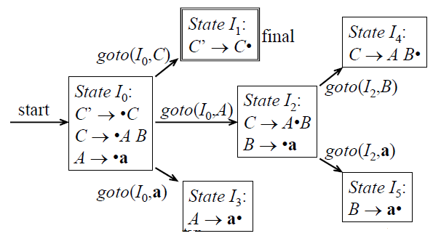
Construction of canonical LR(0) collection
Algorithm:
Augment the grammar by adding production S’ → S
C = { closure({S’→.S}) }
repeat the followings until no more set of LR(0) items can be added to C.
for each I in C and each grammar symbol X
if goto(I,X) is not empty and not in C
add goto(I,X) to C
Example: The augmented grammar is:
C’→C
C→AB
A→a
B→a
I₀ = closure (C’ → •C)
I₁ = goto(I₀,C) = closure(C’ → C•)
and so on

Slide 57
Algorithm for construction of SLR parsing table
Steps to construct SLR parsing table for grammar G are:
Augment G and produce G’
Construct the canonical collection of set of items C for G’
Construct the parsing action function action and goto using the following algorithm that requires FOLLOW(A) for each non-terminal of grammar.
Input : An augmented grammar G’
Output : The SLR parsing table functions action and goto for G’
Method :
Construct C = {I0, I1, …. In}, the collection of sets of LR(0) items for G’.
The parsing functions for state i are determined as follows:
If [A→α∙aβ] is in Ii and goto(Ii,a) = Ij, then set action[i,a] to “shift j”. Here a must be terminal.
If [A→α∙] is in Ii , then set action[i,a] to “reduce A→α” for all a in FOLLOW(A).
If [S’→S.] is in Ii, then set action[i,$] to “accept”. If any conflicting actions are generated by the above rules, we say grammar is not SLR(1).
The goto transitions for state i are constructed for all non-terminals A using the rule: If goto(Ii,A) = Ij, then goto[i,A] = j.
All entries not defined by rules (2) and (3) are made “error”
The initial state of the parser is the one constructed from the set of items containing [S’→.S].

Slide 58
Example: Construct the SLR parsing table for the grammar: { C→AB A→a B→a } and parse the string aaaa using the table.
Augmenting the grammar:
C’→C
C→AB
A→a
B→a
Step 1:- construct the canonical LR(0) collection for the grammar as,
I₀ = Closure({C’ -> .C}) = { C’ -> .C, C -> .AB, A -> .a }
I₁ = Closure(goto(I_{0,} C)) = Closure({ C’ -> C. }) = { C -> C.}
I₂ = closure ( goto(I₀, A)) = { C -> A.B, B->.a}
I₃= closure ( goto(I₀, a)) = { A->a.}
I₄ = closure ( goto(I₂, B)) = { C -> AB.}
I₅ = closure ( goto(I₂, a)) = { B->a.}
Step 2 : Construct SLR parsing table that contains both action and goto table as follows:
Symbols | Action |  | GOTO
States | a | $ | C | A | B
0 | S3 |  | 1 | 2
1 |  | accept
2 | S5 |  |  |  | 4
3 | R3
4 |  | R2
5 |  | R4
Follow (C) = { $}
Follow(A) = { a}
Follow (B) = {a}

Slide 59
Parsing aaa using SLR(1) technique
Stack | Input | Actions
0 | aaa$ | S3
0a3 | aa$ | R3
0A2 | aa$ | S5
0A2a5 | a$ | Error
Parsing aa
C
Stack | Input | Actions
0 | aa$ | S3
0a3 | a$ | R3
0A2 | a$ | S5
0A2a5 | $ | R4
0A2B4 | $ | R2
0C1 | $ | accept
Output Sequence
R3: A -> a
R4: B -> a
R2 : C -> AB
A
B
a
a
Parse tree for string aa

Slide 60
Example for SLR parsing:
Construct SLR parsing table for the following grammar :
E → E + T | T
T → T * F | F
F → (E) | id
Parse whether the input id + id * id is valid or not.

Slide 61
Canonical LR Parsing
SLR is so simple and can only represent the small group of grammar.
C-LR parsing or just LR method makes full use of look-ahead to avoid unnecessary conflicts in parsing table.
This method uses a large set of items, called LR(1) items.
LR(1) item = LR(0) item + look-ahead
LR(0) item: LR(1) item:
[A→α•β] [A→α•β, a]
Computation of Closure for LR(1)Items:
1. Start with closure(I) = I (where I is a set of LR(1) items)
2. If [A→α•Bβ, a] є closure(I) then
add the item [B→•γ, b] to I if not already in I, where b є FIRST(βa).
3. Repeat 2 until no new items can be added.

Slide 62
Computation of Goto Operation for LR(1) Items
If I is a set of LR(1) items and X is a grammar symbol (terminal or non-terminal), then goto(I,X) is computed as follows:
1. For each item [A→α•Xβ, a] ∈ I, add the set of items
closure({[A→αX•β, a]}) to goto(I,X) if not already there
2. Repeat step 1 until no more items can be added to goto(I,X)
Construction of The Canonical LR(1) Collection
Algorithm:
Augment the grammar with production S’→S
C = { closure({S’→.S,$}) } (the start stat of DFA)
repeat the followings until no more set of LR(1) items can be added to C.
for each I ∈ C and each grammar symbol X ∈ (N∪T)
goto(I,X) ≠ φ and goto(I,X) not ∈ C then
add goto(I,X) to C

Slide 63
Constructing LR(1) Parsing Table
Algorithm:
1. Construct the canonical collection of sets of LR(1) items for G’.
C = {I0... In}
2. Create the parsing action table as follows
• If [A→α.aβ,b] in Ii and goto(Ii,a) = Ij then action[i,a] = shift j.
• If A→α., a is in Ii, then action[i,a] = reduce A→α where A≠S’.
• If S’→S.,$ is in Ii , then action[i,$] = accept.
• If any conflicting actions generated by these rules, the grammar is not LR(1).
3. Create the parsing goto table
• for all non-terminals A, if goto(Ii,A) = Ij then goto[i,A] = j
4. All entries not defined by (2) and (3) are errors.
5. Initial state of the parser contains S’→.S, $

Slide 64
Example:
Construct canonical LR(1) collection of the grammer:
S→AaAb
S→BbBa
A→∈
B→∈
Step 1: Its augmented grammar is:
S’→S
S→AaAb
S→BbBa
A→є
B→є
Step 2: The canonical LR(1) collection of items:
I₀ = closure ( [S’ -> .S,$]) = { [S’ -> .S, $] , [S -> .AaAb,$], [S -> .BbBa, $], [A -> . , a], [B -> ., b] }
I₁= goto( I_{0,} S) = closure ( [S’ -> S., $]) = { [S’ -> S. , $] }
I₂= goto( I_{0,} A) = closure ( [S’ -> A.aAb, $]) = { [S’ -> A.aAb , $] }
I₃= goto( I_{0,} B) = closure ( [S’ -> B.bBa, $]) = { [S’ -> B.bBa , $] }

Slide 65
LR(1) collection of items
I₄= goto( I_{2,} a) = closure ( [S’ -> Aa.Ab, $]) = { [S’ -> Aa.Ab , $], [A ->., b] }
I₅= goto( I_{3,} b) = closure ( [S’ -> Bb.Ba, $]) = { [S’ -> Bb.Ba , $], [B ->., a] }
I₆= goto( I_{4,} A) = closure ( [S’ -> AaA.b, $]) = { [S’ -> AaA.b , $]}
I₇= goto( I_{5,} B) = closure ( [S’ -> BbB.a, $]) = { [S’ -> BbB.a , $] }
I₈= goto( I_{6,} b) = closure ( [S’ -> AaAb., $]) = { [S’ -> AaAb., $] }
I₉= goto( I_{7,} a) = closure ( [S’ -> BbBa., $]) = { [S’ -> BbBa. , $] }

Slide 66
LR(1) Parsing Table
 | Action |  |  | GOTO
States | a | b | $ | S | A | B
0 | R4 | R5 |  | 1 | 2 | 3
1 |  |  | accept
2 | S4
3 |  | S5
4 |  | R4 |  |  | 6
5 | R5 |  |  |  |  | 7
6 |  | S8
7 | S9
8 |  |  | R2
9 |  |  | R3

Slide 67
Parsing LR(1) algorithm for the input string: aba
Stack | Input | Actions
0 | aba$ | R4
0A2 | aba$ | S4
0A2a4 | ba$ | R4
0A2a4A6 | ba$ | S8
0A2a4A6b8 | a$ | Error
Parsing LR(1) algorithm for the input string: ab
Stack | Input | Actions
0 | ab$ | R4
0A2 | ab$ | S4
0A2a4 | b$ | R4
0A2a4A6 | b$ | S8
0A2a4A6b8 | $ | R2
0S1 | $ | accept
S
Output Sequence
R4: A -> ϵ
R4 : A -> ϵ
R2 : S -> AaAb
A
a
A
b
ϵ
ϵ
Parse Tree for string ab

Slide 68
Exercise:
Construct LR(1) parsing table for the augmented grammar,
1. S’ → S
2. S → L = R
3. S → R
4. L → * R
5. L → id
6. R → L
Trace the LR(1) parsing algorithm for the input string: *id = id

Slide 69
LALR(1) Parsing
It is an intermediate grammar between the SLR and LR(1) grammar.
A typical programming language generates thousands of states for canonical LR parsers while they generate only hundreds of states for LALR parser.
The number of states in SLR and LALR parsing tables for a grammar G are equal.
But LALR parsers recognize more grammars than SLR parsers.
LALR(1) parser combines two or more LR(1) sets (whose core parts are same) into a single state to reduce the table size.
If Ii and Ij have more than one items, then the set of all core elements in Ii should be the same as the set of all core elements in Ij for the union operation to be possible.
Union operations do not create any new shift-reduce conﬂicts, but can create new reduce-reduce conﬂicts. Shift operation depends only on the core and not on the next input symbol.
Example:
I₁: L → id. , =
I₂: L → id. , $
I₁₂: L → id. , =/$

Slide 70
Constructing LALR Parsing Tables
Create the canonical LR(1) collection of the sets of LR(1) items for the given grammar C={I₀,...,In} .
Find each core; find all sets having that same core; replace those sets having same cores with a single set which is their union. C={I0,...,In} then C’={J1,...,Jm}where m ≤ n
Create the parsing tables (action and goto tables) same as the construction of the parsing tables of LR(1) parser.
– Note that: If J=I1 ∪ ... ∪ Ik since I1,...,Ik have same cores then cores of goto(I1,X),...,goto(I2,X) must be same. So, goto(J,X)=K where K is the union of all sets of items having same cores as goto(I1,X).
If no conflict is introduced, the grammar is LALR(1) grammar.
(We may only introduce reduce/reduce conflicts; we cannot introduce a hift/reduce conflict)

Slide 71
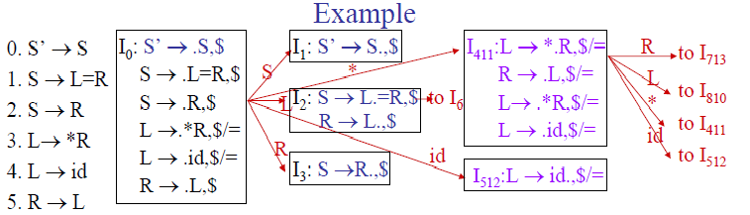
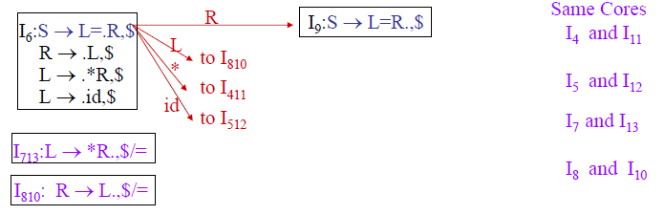

Slide 72
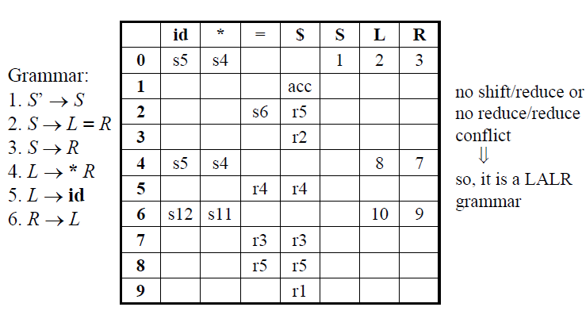
Note: The above technique of LALR algorithm is however inefficient since it constructs the entire canonical DFA before generating the LALR parsing table

Slide 73
KERNEL AND NON-KERNEL ITEMS
In order to devise a more efficient way of building LALR parsing tables, we deﬁne the terms kernel items and non-kernel items.
Kernel item:
This includes the initial items, S’→S and all items whose dot are not at the left end.
Other than the initial item [S' →·S,$] no other item generated by a goto has a dot at the left end of the production.
Non-Kernel item:
The productions of a grammar which have their dots at the left end are non-kernel items.
Items that are generated by closure over kernel items have a dot at the beginning of the production.

Slide 74
Example:
Consider the augmented grammar
S' → S
S → L = R | R
L →∗R | id
R → L
The kernels of the set of LR(0) items are:
I₀ = {S' →·S}
I₁ = {S' → S·}
I₂ = {S → L· = R, R → L·}
I₃ = {S → R·}
I₄ = {L →∗·R}
I₅ = {L → id·}
I₆ = {S → L = ·R}
I₇ = {L →∗R·}
I₈ = {R → L·}
I₉ = {S → L = R·}

Slide 75
Thank You !

